Slide 1

Infinite Computer Solutions
Capstone Project on
Infinite Banking Wallet
By,
Dandamudi Naren
Sai Nikhil Kothakonda
Sindhu Peddi
Subhash Nalla
Yashaswini Vijay

Slide 2
CONTENT
Abstract
Introduction
Objective
Feature Available
Software Requirements
Block Diagram
Methodology
Result
Scope
Conclusion

Slide 3
ABSTARCT
Online banking, also known as internet banking, virtual banking, web banking .This facilitate customers to perform bank related operations without visiting Branch, at any given place at the click of button.
Our Infinite banking wallet is one of the online platform where the customer can avail various services like Enquiry, Account opening / closure, fund transfer, online Tax, bill payments, mutual funds and the customer data will be is secured by the system.
The Banking Wallet is designed by the Integrating the Spring Boot as a backend with React JavaScript as a frontend part and MySQL as a database server.

Slide 4
INTRODUCTION
The Wallet App project is a comprehensive Payment Wallet Application developed in Java using Spring Boot, with a MySQL database backend along with React Java script. The primary goal of this project is to provide a secure and efficient platform for customers to make payments using digital wallets during their purchases. The application includes a Graphical User Interface (GUI) built with React, ensuring a user-friendly experience. This documentation provides an overview of the key features and technologies utilized in the Wallet App.

Slide 5
OBJECTIVE
User-Friendly Interface
Seamless Transactions
Financial Empowerment
Security and Authentication
Comprehensive User Management
Record-Keeping and Transparency
Flexibility and Convenience

Slide 6
FEATURES AVAILABLE
Bill Payments
Wallet Transactions
Card Management
Financial Information
Stock Market Insights
Mutual funds
User Profile Management

Slide 7
SOFTWARE REQUIREMETS
Technology Stack
Front End: React Java Script and Visual Studio
Utilizes React for building a responsive and dynamic user interface.
Database: MySQL database
MySQL is employed as the backend database to store user information and transaction data securely.
Programming: Spring Boot with Layered Architecture
The backend is developed using Spring Boot, following a layered architecture to ensure modularity and maintainability.
IDE Used: Eclipse/STS
Developed using Eclipse or Spring Tool Suite (STS) for efficient coding and project management.

Slide 8
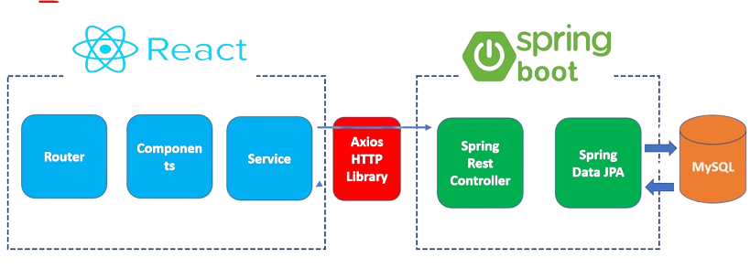
BLOCK DIAGRAM

Slide 9
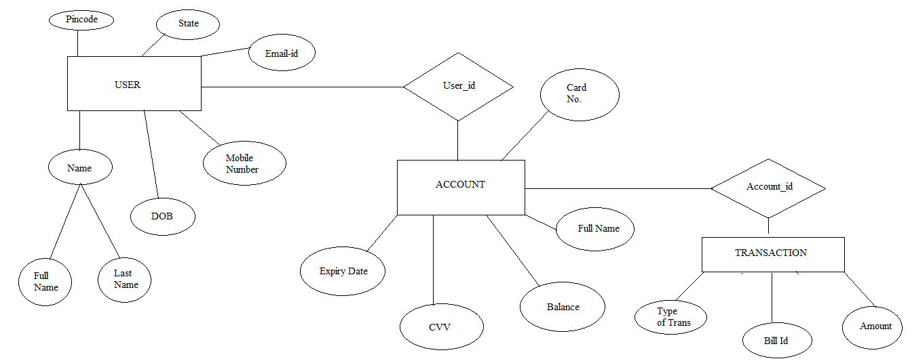
METHODOLOGY
ER DIAGRAM

Slide 10
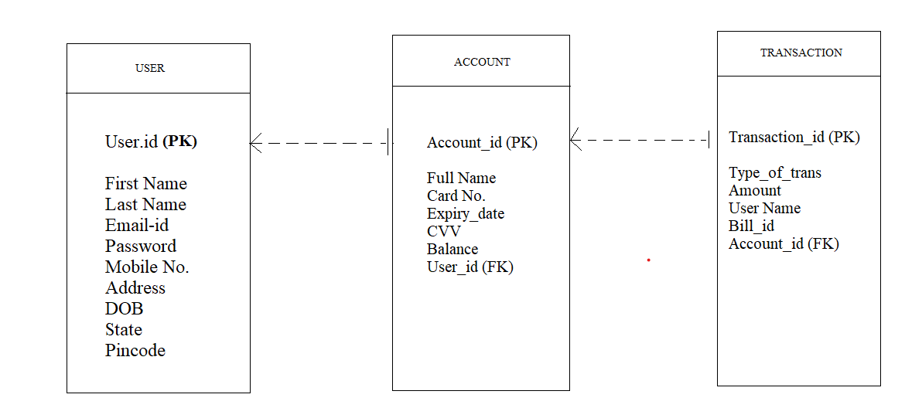
CLASS DIAGRAM

Slide 11
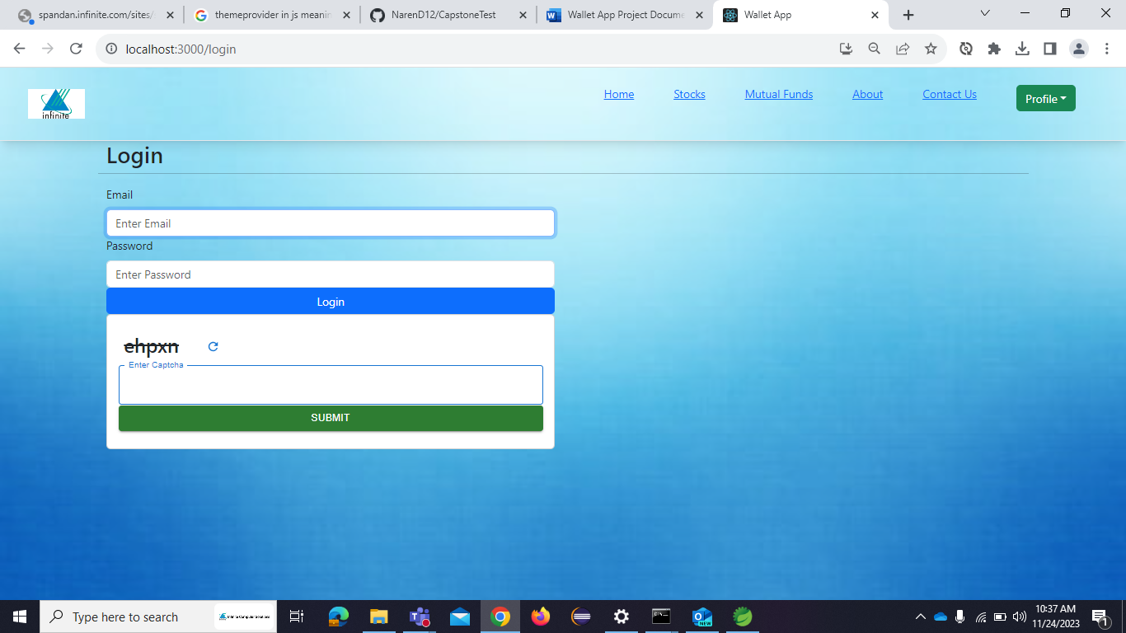
RESULT
Login Page

Slide 12
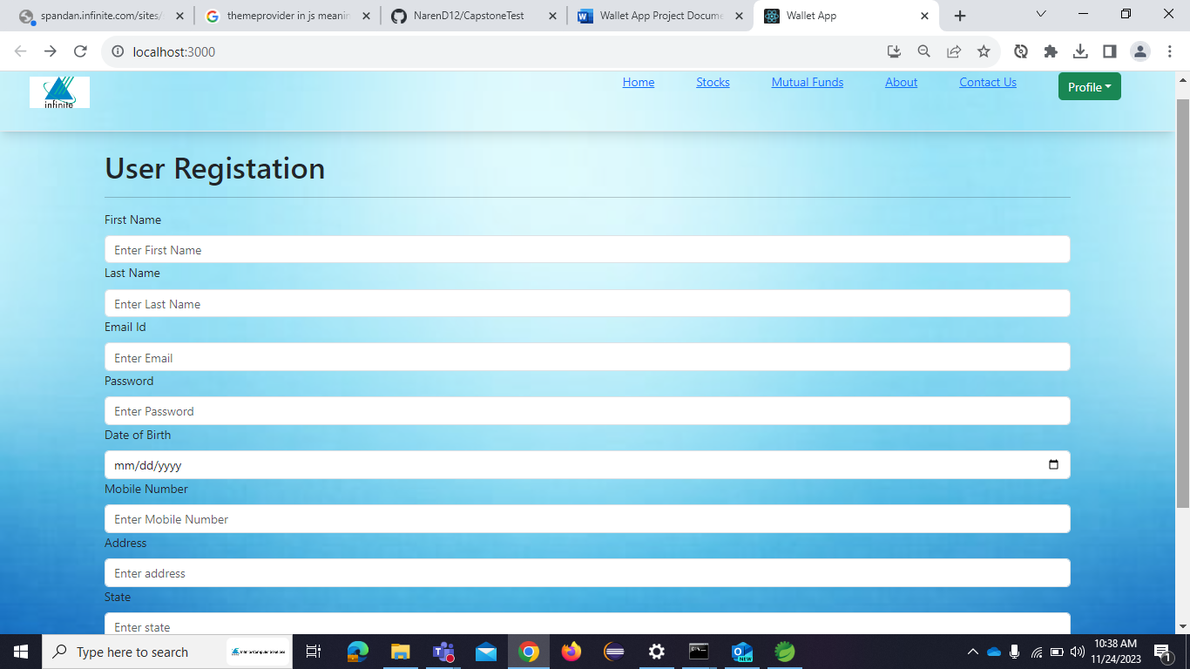
2. Registration Page

Slide 13
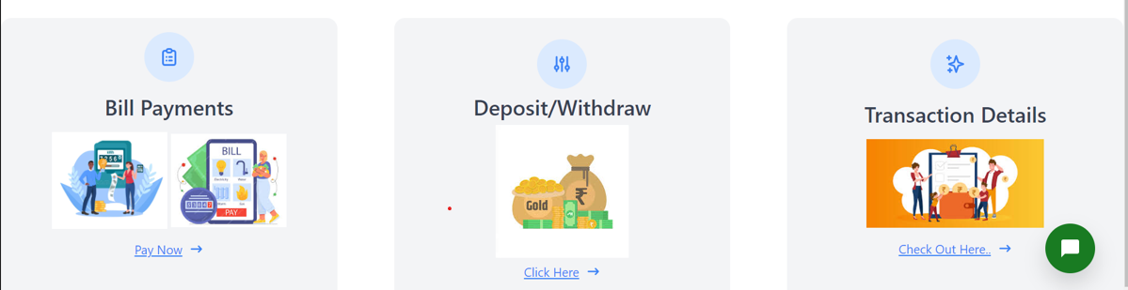
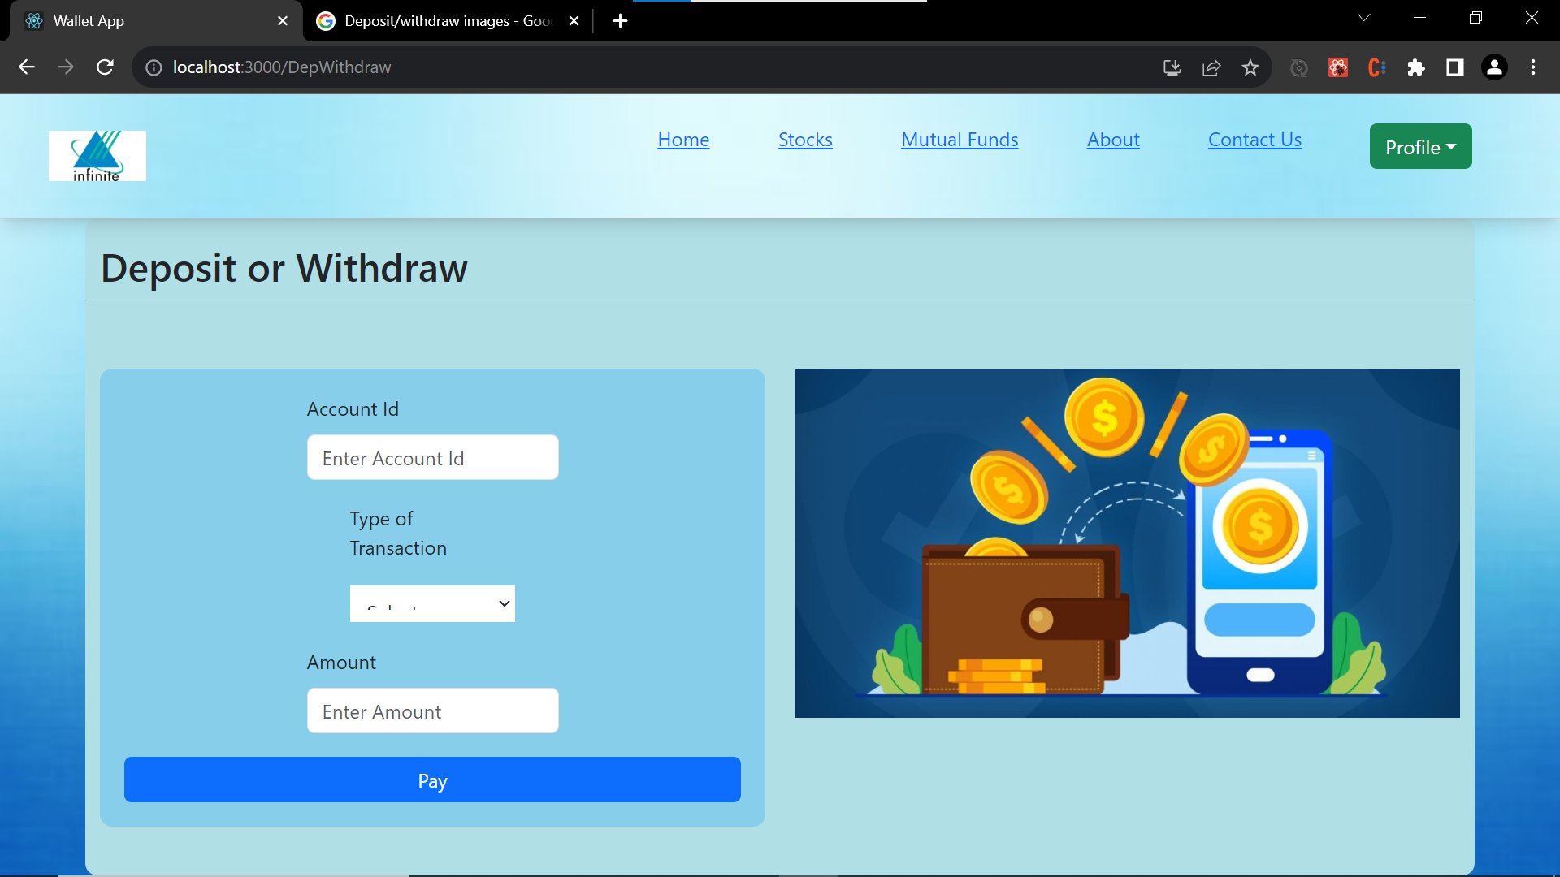
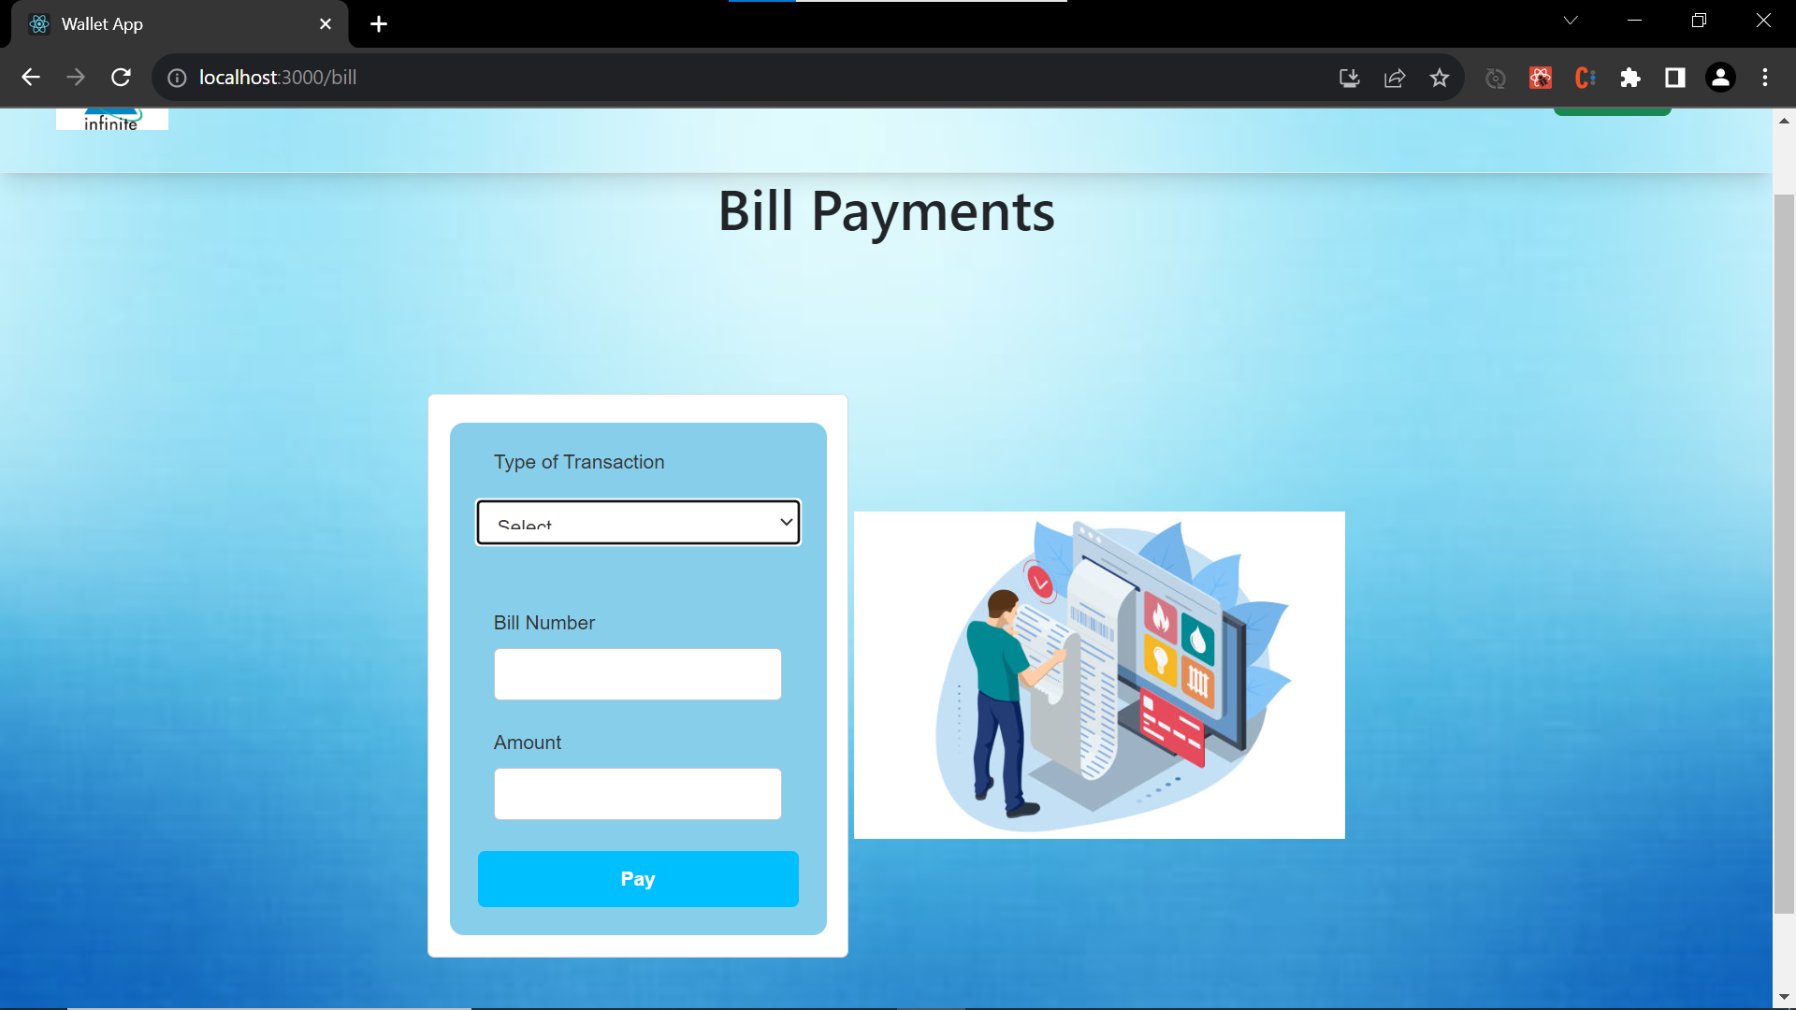
3 . ONLINE TRANACTION PAGE

Slide 14
FUTURE SCOPE
By using online transaction we can digitalize the money.
Daily Market growth is available in fingertips.

Slide 15
CONCLUSION
Successfully created the Wallet Banking app with user friendly configurations. Implementation of a banking wallet project is not only enhance customer convenience but also streamlines financial transactions. The secure and user-friendly nature of net banking contributes to a modern and efficient banking experience, fostering digital financial inclusion in an increasingly connected world.

Slide 16
THANK YOU

